Slide 1
I400 – Application Development in Java
Lab 2

Slide 2
Today
Language Practice
Loops & Conditionals
Random numbers

Slide 3
Language Practice
Today you’ll be practicing the Java basics you’ve learned so far.
All problems (but not their solutions) are on the prelim slides.
Work at your group’s pace. When you’re done, work on HW 1 individually!

Slide 4
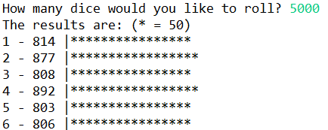
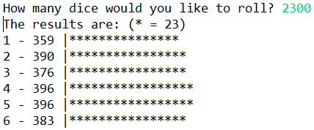
Dice Stats (Group Work)
Write the DiceStats class, where we input a number of standard 6-sided die rolls to make. The program output stats about the rolls, as well as a rough histogram using percent units (* = ~1% of the total number) .
Note: This code would be much simpler if we could write our own methods, but we haven’t seen that – yet! If you’re working ahead, feel free to.

Slide 5
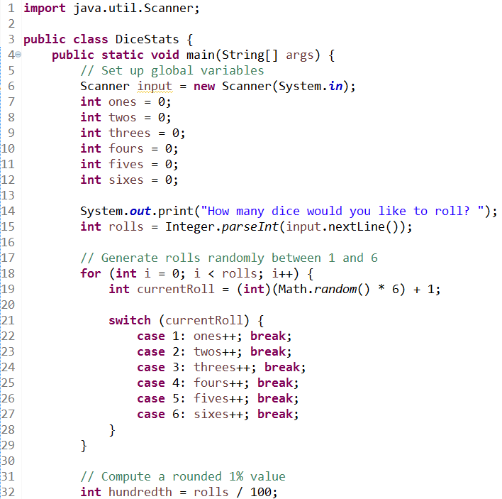
Dice Stats (Solution pt 1)

Slide 6
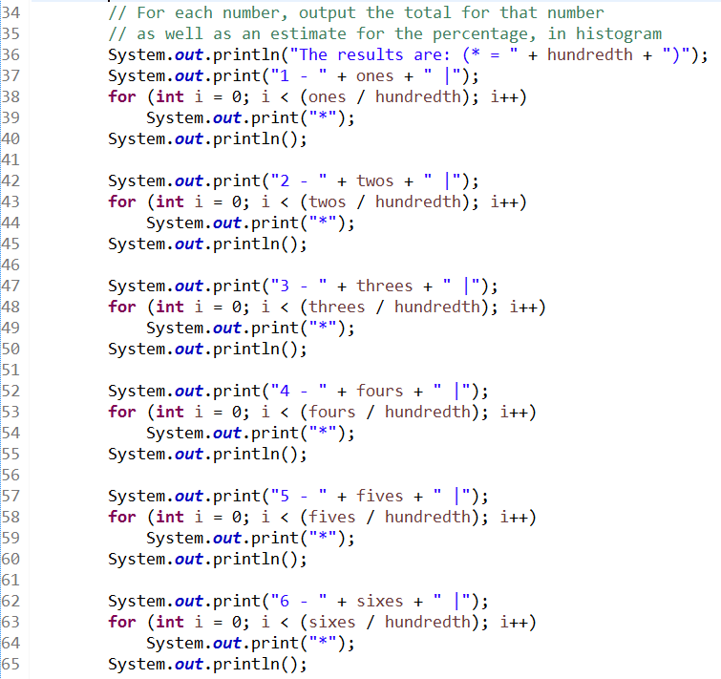
Dice Stats (Solution pt 2)

Slide 7
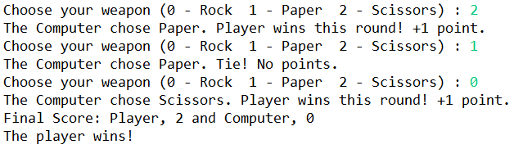
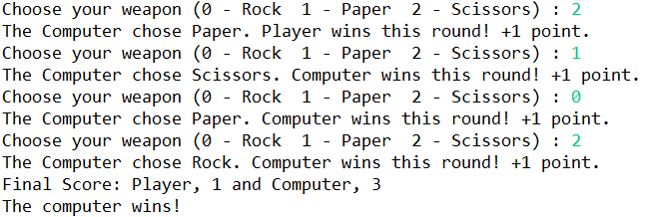
Rock Paper Scissors (Group Work)
Write the RPS class, where a human plays Rock Paper Scissors against the computer, who choses randomly. The game ends when one player has two more wins than their opponent.

Slide 8
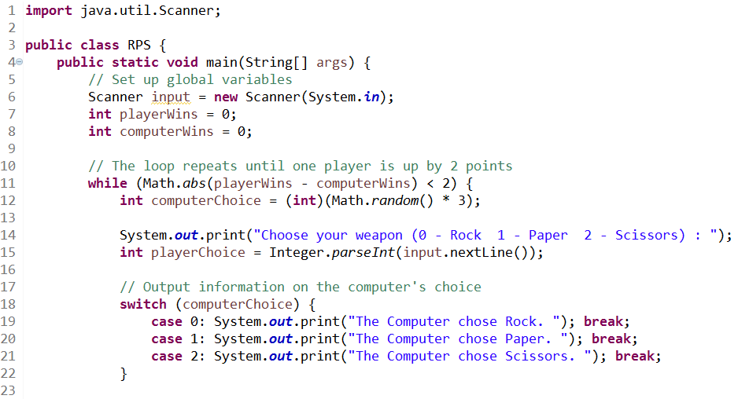
Rock Paper Scissors (Solution pt 1)

Slide 9
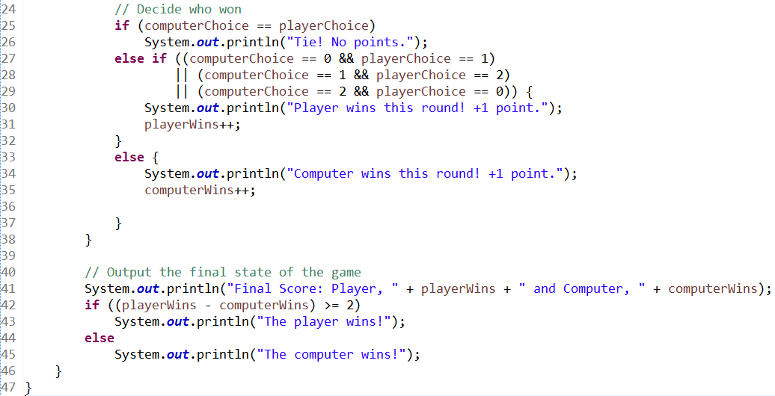
Rock Paper Scissors (Solution pt 2)

Slide 10
Questions?

